Slide 1

JaRVIS The voice assistant
Tittle of the project

Slide 2
MAHARASHTRA STATE BOARD OF TECHNICAL EDUCATION, MUMBAI
A PROJECT REPORT ON
Voice Assistant Using Python
Under the Guidance of
MRS. MALU SARIKA
Lecturer
Dept. of Computer Technology
Submitted by
SR NO | Name of The Student | Enrollment No | Seat No
1 | Malleshe Ganesh Sangram | 2000320117 | 372007
2 | Solanakar Abhijeet Angad | 2000320142 | 372029
3 | Govindwad Sujal Vynkat | 2000320103 | 371996

Slide 3
INDEX
Introduction
Packages used
Features of Jarvis
Advantages & Disadvantages
Future Scope
References
Conclusion

Slide 4
INTRODUCTION
In today’s world almost all tasks are digitalized. We have Smartphone in hands and it is nothing less than having world at your fingertips. These days we aren’t even using fingers. We just speak of the task and it is done. There exist systems where we can say Text Dad, “I’ll be late today.” And the text is sent. That is the task of our Jarvis .
It also supports specialized task such as clicking a photo , finding information about anyone in Wikipedia ,Telling News like sports, business, politics etc. as per user requirement , opening various application like word, Notepad , command prompt etc.
JARVIS is effortless to use. Call the wake Up “ JARVIS ’ followed by the command. And within seconds, it gets executed. Voice searches have dominated over text search. Virtual assistants are turning out to be smarter than ever. Allow your intelligent assistant to make email work for you. Detect intent, pick out important information, automate processes, and deliver personalized responses.

Slide 5
In this project we have used following Packages to build the Jarvis:
Speech Recognition:
Speech Recognition library is used for listening to the words spoken by the users that is taken as input from microphone as a source and then process it for finding out its meaning and convert them into text format. This library allows machine system to understand the human language.
Pyttsx3:
Pyttsx3 stands for Python text to speech library is used for making our voice assistant talk to us. It supports common text to speech engines which is like a tool that converts text into speech and makes voice assistant able to talk to its user. We can make it talking in both male and female voices according to requirement.
Wikipedia:
We need to use Wikipedia library so that we can get information from Wikipedia on any topic or we can also ask for solution to our query or simply we can perform Wikipedia search for any topic using this library. This Library in python needs Internet connection for fetching results and it will provide results to user in text as well as voice format.

Slide 6
Datetime:
This is an essential module to support the functionality of Date and time. Whenever user wants to know the current date and time or the user wants to schedule a task at a certain time then this module will be helpful to them.
PyAutoGUI:
PyAutoGUL is a Python Package which has control over the mouse and the keyboard it is able to simulate the mouse cursor moves as well as clicks the button press. With the help of particular 2-D coordinate we can click on exact location on screen.
PyWhatkit:
PyWhatKit is a Python Library which has number of features like Sending messages, images through WhatsApp, playing YouTube videos, converting image to ASCII, sending emails etc.

Slide 7
Keyboard:
Keyboard is library in Python which provides user the full control over the Keyboard. Especially the ‘press ()’ and ‘write ()’ function helps for controlling keyboard keys as well as writing messages on screen.
SpeedTest:
Speedtest library is essential to test internet bandwidth. It helps to evaluate the uploading as well as downloading speed of Internet. All the result that we get are in Megabits.
OS:
OS (Operating System) module in Python is used for interacting with operating system. Particularly we are using the ‘Start file ()’ to open any application that are installed in our system.

Slide 8
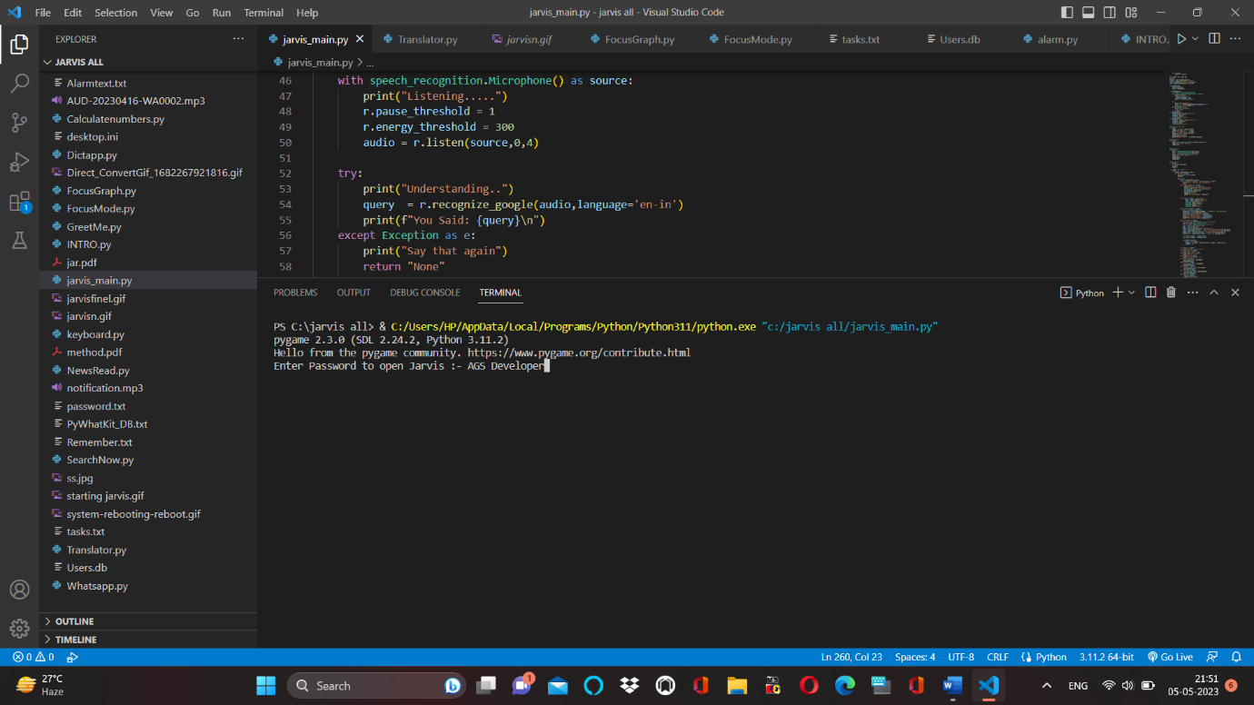
FEATURES OF JARVIS:
Password Protection for Jarvis(Voice Assistant):

Slide 9
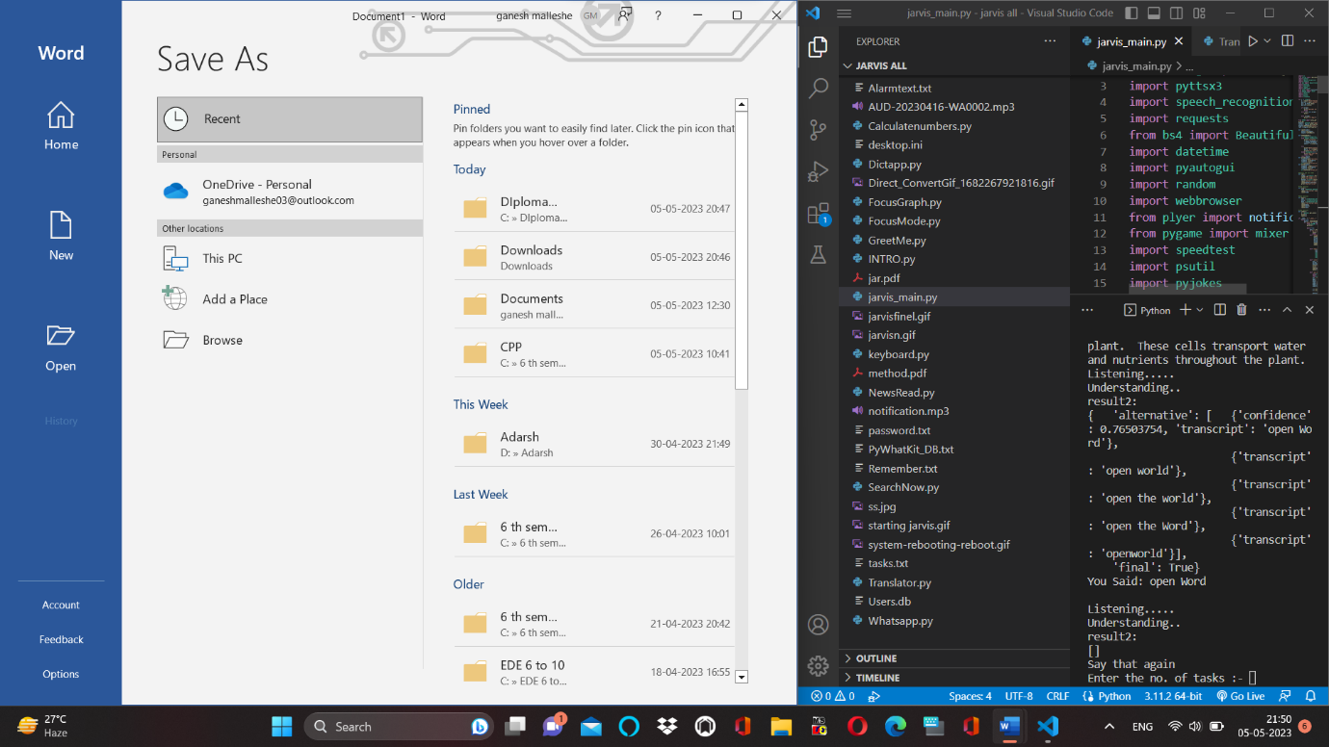
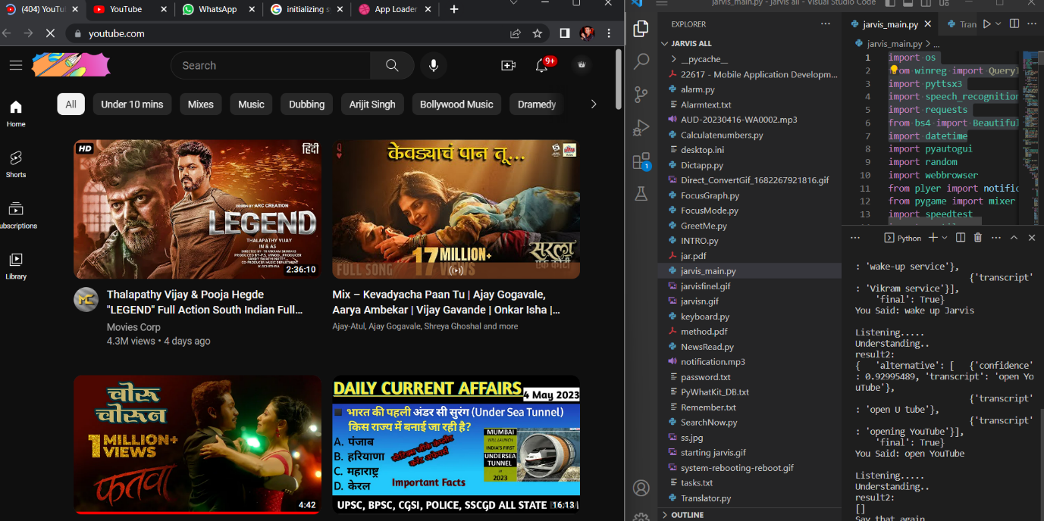
Open “Word” Command:
Open “Youtube” Command:

Slide 10
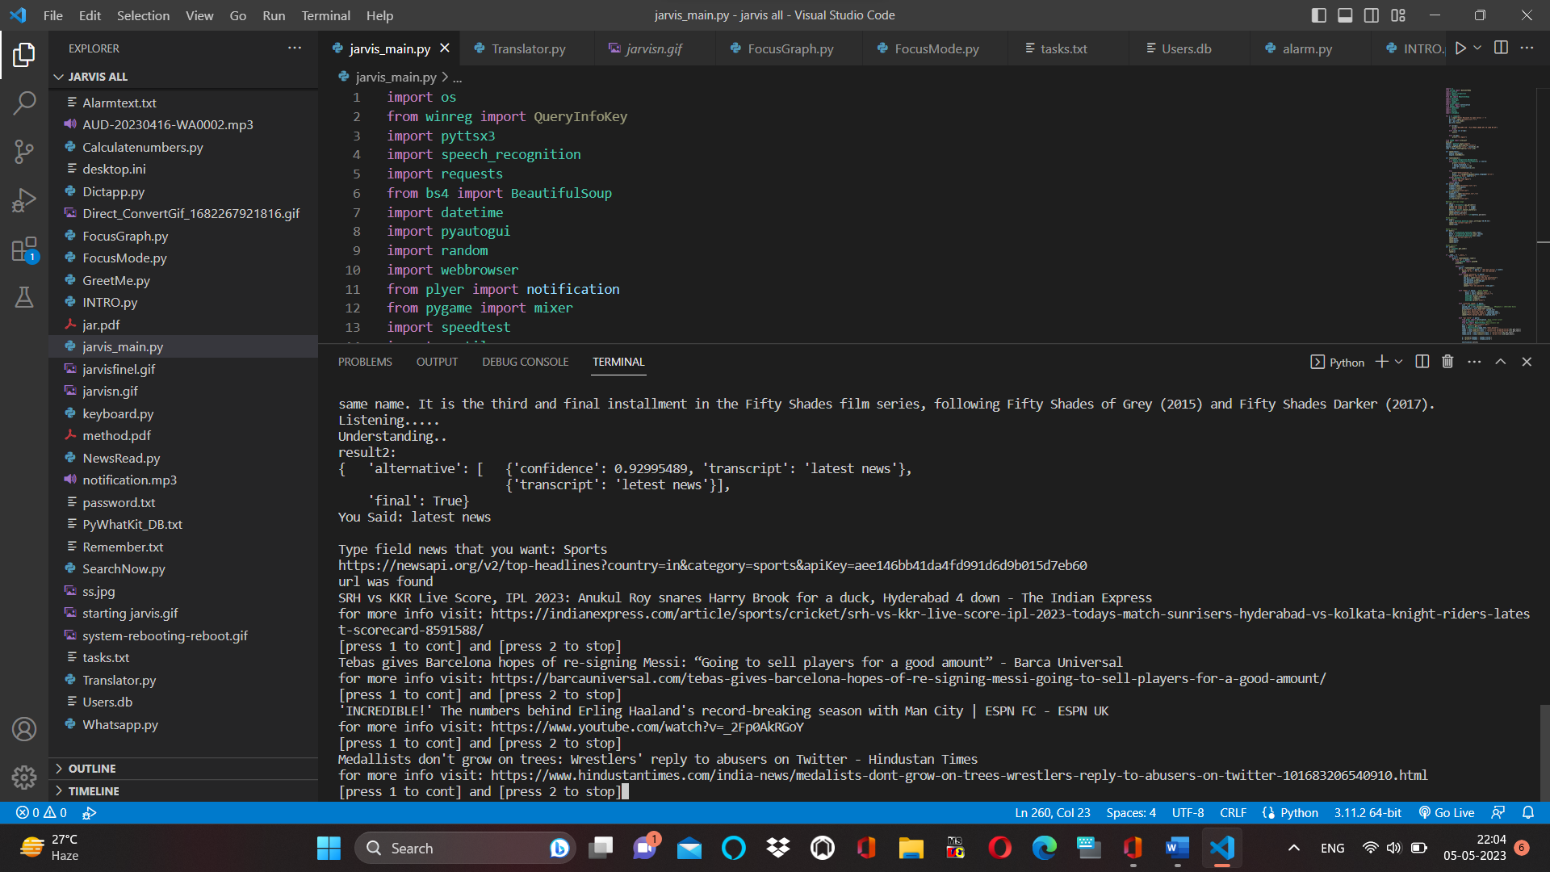
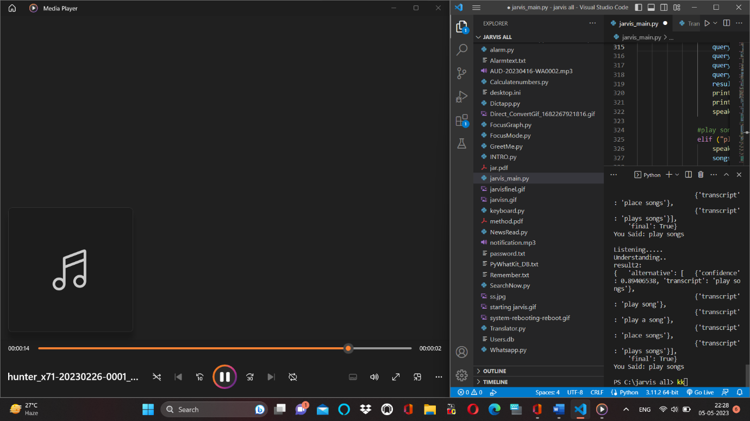
Ability Of Telling News:
Ability of Playing Songs:

Slide 11
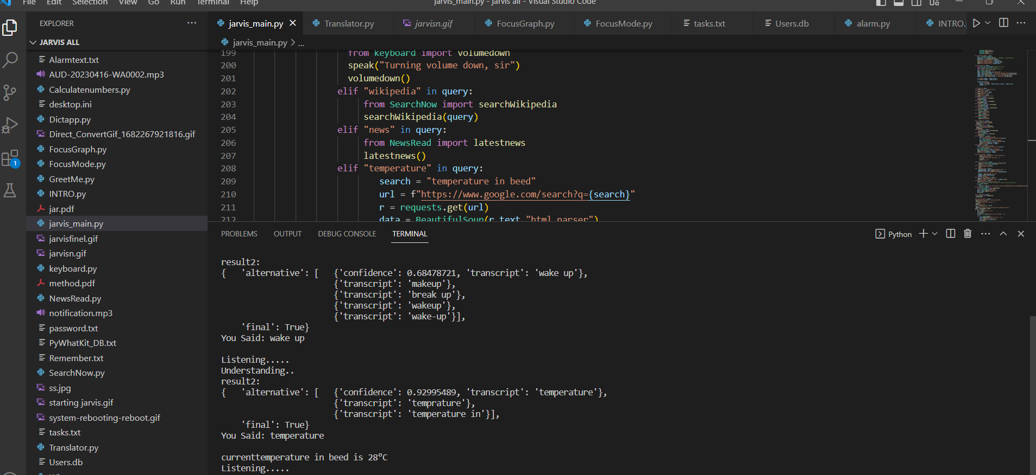
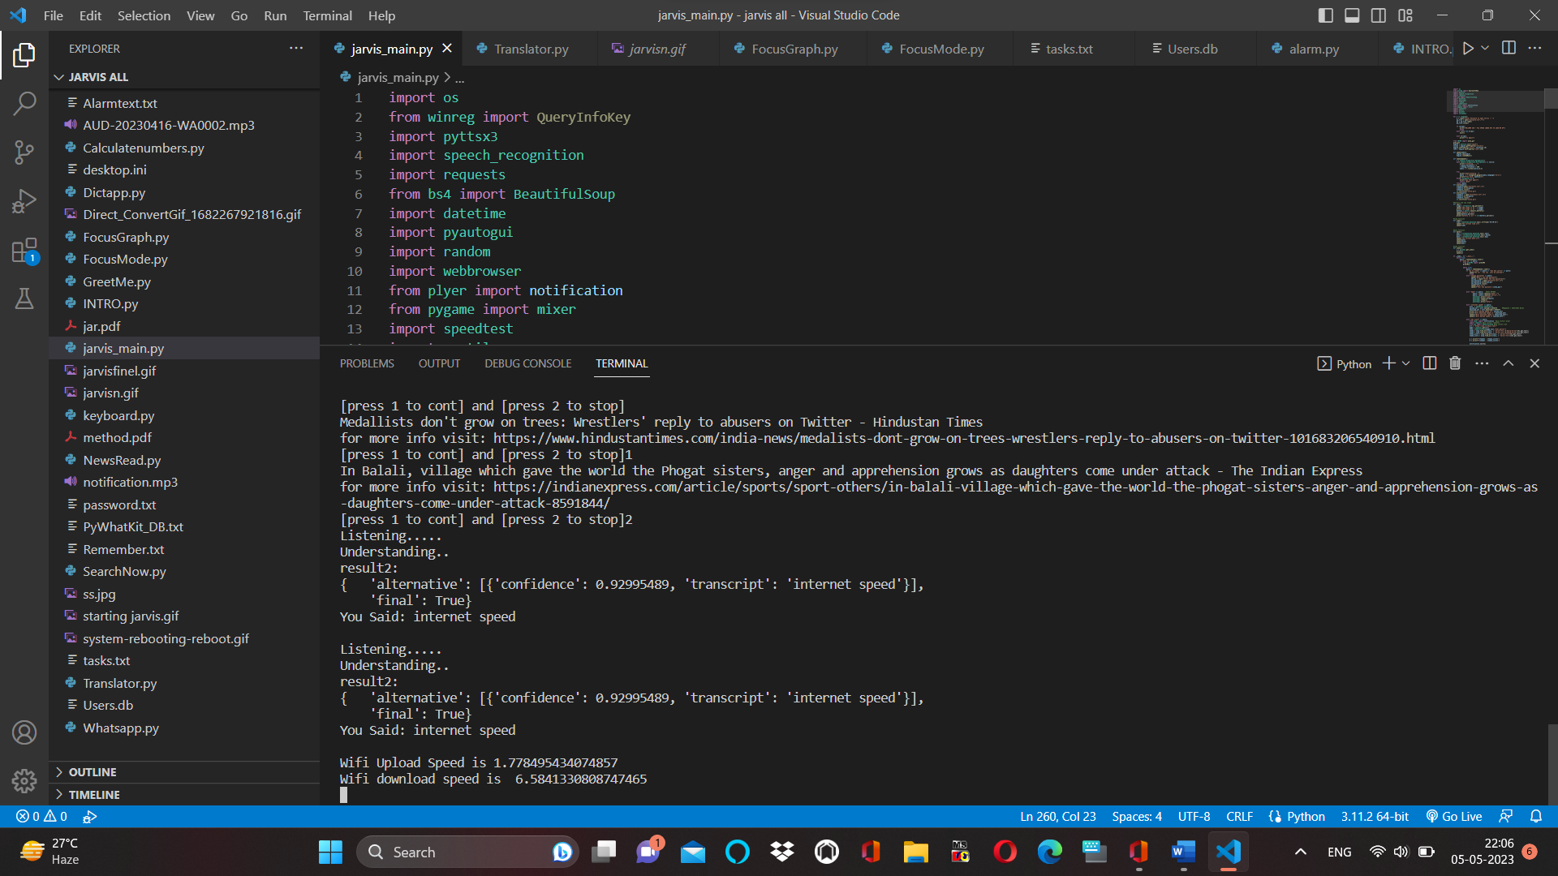
Ability of Telling Current Temperature:
Ability of Telling Internet Speed:

Slide 12
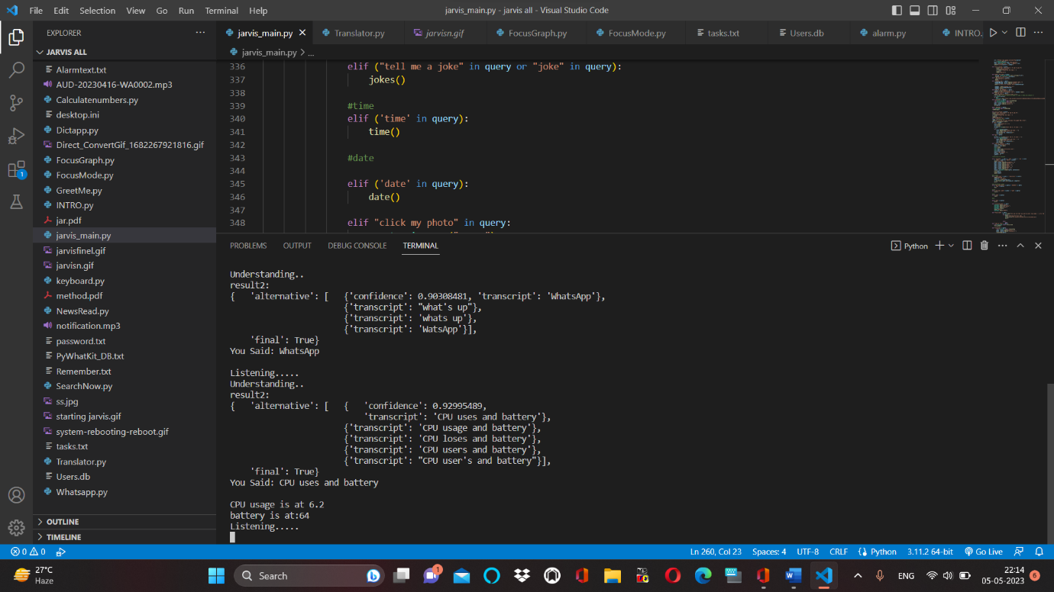
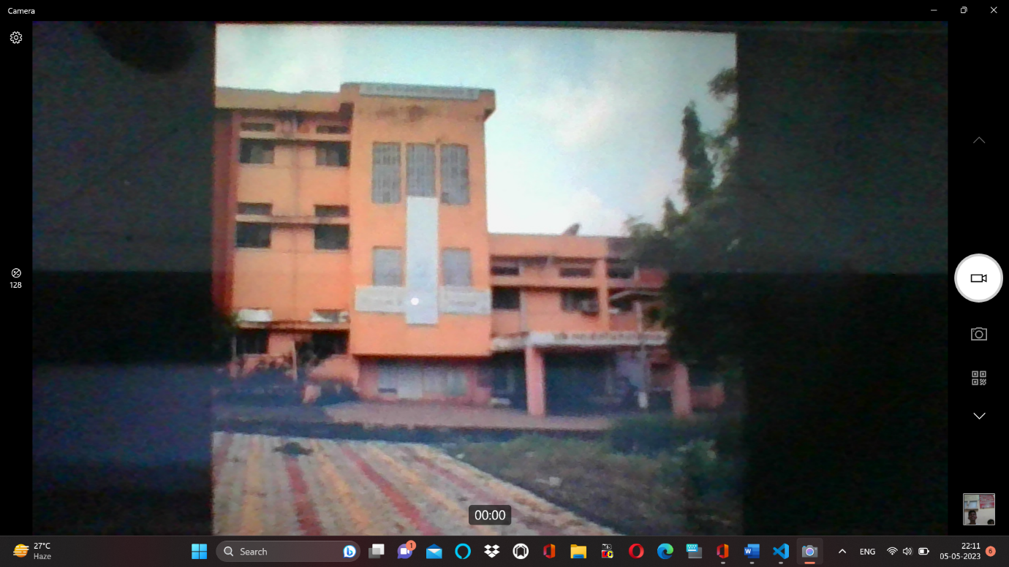
Ability of Telling Battery and CPU Status:
Ability to Click a Photo:

Slide 13
ADVANTAGES:
Convenience:
One of the biggest advantages of using voice assistants is their convenience. Users can perform tasks without having to use their hands or look at a screen. This can be particularly useful when driving, cooking, or exercising.
Accessibility:
Voice assistants can be very helpful for people with disabilities or those who have difficulty using a keyboard or touch screen. Voice commands can allow users to perform tasks that would otherwise be difficult or impossible.
Personalization:
Voice assistants can be personalized to suit individual preferences. Users can choose the accent, language, and even the name of their assistant. They can also customize settings, such as music preferences, and create reminders and alerts.
Efficiency:
Voice assistants can save time by performing tasks quickly and accurately. They can also handle multiple tasks at once, such as setting a timer and playing music, without interrupting the user.

Slide 14
DISADVANTAGES:
Privacy concerns:
Voice assistants are always listening for their wake word and may record and transmit conversations accidentally or on purpose. This can raise concerns about privacy and data security.
Inaccuracy:
Voice assistants may misinterpret commands, particularly if the user has a strong accent or speaks too quickly. This can be frustrating and may require repeating the command multiple times.
Limited capabilities:
Voice assistants may not be able to perform all tasks, particularly complex ones that require multiple steps or involve visual information.
Dependence:
Overreliance on voice assistants may lead to a loss of basic skills, such as typing or reading. It can also limit critical thinking and decision-making abilities.

Slide 15
FUTURE SCOPE:
The future scope of voice assistants is vast, and they are expected to become even more prevalent and advanced in the coming years. Here are some potential areas of growth and development for voice assistants:
Integration with more devices:
Voice assistants are likely to become even more integrated with devices in the home, office, and public spaces. This could include everything from cars to smart buildings, making it easier for users to control their environment with voice commands.
Improved natural language processing:
As natural language processing technology continues to improve, voice assistants will become even better at understanding and responding to spoken commands. This could lead to more accurate and reliable voice recognition, as well as more advanced conversation capabilities.
Personalization:
Voice assistants are likely to become even more personalized to individual users, with the ability to recognize and respond to individual voices and preferences. This could lead to more customized recommendations and services.

Slide 16
4.Improved privacy and security:
As privacy concerns continue to be a major issue for users, voice assistants are likely to become even more secure and private. This could include better encryption and data protection, as well as more transparent data collection policies.
5.Integration with AI and machine learning:
As AI and machine learning technology continue to develop, voice assistants are likely to become even more intelligent and adaptive. They could be used to power chatbots, customer service interactions, and more.

Slide 17
REFERENCES:
Websites referred
www.stackoverflow.com
www.pythonprogramming.net
www.codecademy.com
www.tutorialspoint.com
www.google.co.in
YouTube Channels referred
Scientific Coder
Code with Harry

Slide 18
CONCLUSION:
In this Project we have discussed uses, methodology as well as implementation details of the personal Desktop based voice assistant using Python which is built using open-source software VS Code as an implementation tool. This Project will be helpful for people of all generations as well as to people with some disabilities or people with some special cases.
The personal voice assistant will be easy to use and will reduce the manual human efforts for performing various tasks. The functionality of the current voice assistant system is limited to working on Desktop based and working online (required to have internet connection to perform tasks) only. The voice assistant system is modular in nature so that addition of new features is possible without disturbing current system functionalities.

Slide 19
Thank You

